Slide 1
Meredith College
HIED 545
Emily Lane
Penn State University
Mid-Coursse Presentation
Retrieved: www.meredith.edu, 2020
Notes:
Hello, My name is Emily Lane and I will be presenting a brief timeline, description of governance, financial analysis, and structural analysis of Meredith College.
Meredith college is an all women's liberal arts college that has a current enrollment of 1,980 undergraduate students. It is located in Raleigh, North Carolina in the "research triangle". Historically Meredith College was a Baptist College, but in 2009 ties were broken with the religious community to further pursue autonomy and gender equality. [click]

Slide 2
The Carnegie Classification and Rankings
Notes:
First, Let's analyze the Carnegie classification. [click]

Slide 3
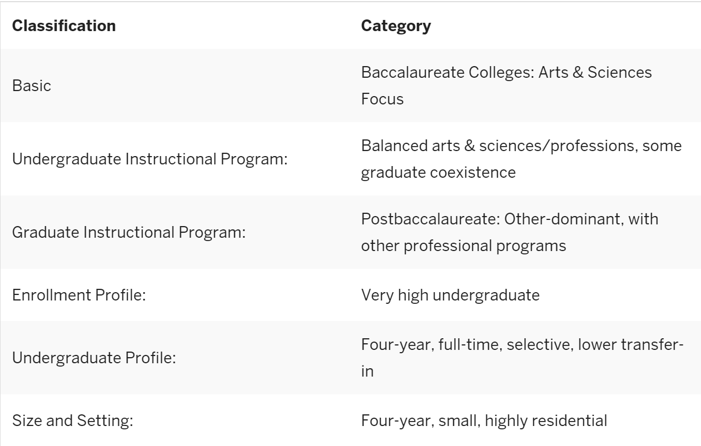
MEREDITH COLLEGE’S
CARNEGIE
CLASSIFICATION
Awesome layout
Golden grid system.
Retrieved:https://carnegieclassifications.iu.edu/lookup/view_institution.php?limit=0,50&clq=&start_page=lookup.php&backurl=lookup.php&unit_id=198950&submit=FIND, 2020
Notes:
The first two categories we will evaluate are [click] Basic and the Undergraduate Instructional Program. "Four-year colleges and universities are skewed, in number of institutions toward the Professional Plus Arts and Sciences (31%) and Professions Focus (30%). Enrollments in the four-year sector, are more normally distributed across this spectrum, with a skew toward the Professions Plus Arts and Sciences, and Professions Focus institutions". Meredith College is ranked as "Balances Arts & Sciences/Professions", a category that only 23% of institutions fell into in 2017. This suggests that Meredith is not focusing their attention, recruitment, or financial aspects on one departmental area of focus, but spreads its attention evenly between professional, artistic, and scientific program focus. (Carnegie classifications pg. 3-4)
This is a theme among liberal arts colleges in comparison to larger universities. [click x2]
The student level mix is classified as “very high undergraduate” for Meredith college which is evenly distributed with exclusively undergraduate four-year at 18% and high undergraduate at 8%. Understandably this distribution is skewed towards institutions that are exclusively undergraduate two-year programs (34%) as these probably include institutions with higher accessibility such as community colleges.
This undergraduate profile is unsurprising as they are a specialized institution. Many of the traditions that make up a student's experience are rooted in history and carried on to integrate the current students into this history on a personal level. [click x2] Meredith's undergraduate profile includes the classifications of: Four-year, full-time (65%), selective (27%), lower transfer-in (30%) where the percentages refer to the category, they fall into versus all institutions ranked. Students are encouraged to graduate in a four-year time after being a full-time student because many of the activities that students are involved in are split into graduating classes.
Along these same lines, [click x2] Meredith being classified as being small (28%) and highly residential (34%) compared to the 2,576 other institutions that are classified is also unsurprising. Residential students are available to participate in many more on-campus events that non-residential students find inaccessible. Each event, whether traditional, educational, or just for fun, plays a part in the overall student experience. This experience is a large reason why students choose to attend Meredith college as it is unique and geared towards the specific goal of educating women. (Carnegie classifications pg. 4-6)
[click x2]
Finally the level, control, and student population reflect again that Meredith is a 4-year or above university that is classified as being private not-for-profit with an overall student population as of Fall 2017 of 1,980 students. [click]
The Carnegie Classification of Institutions of Higher Education ®. (n.d.). Retrieved January 29, 2020, from https://carnegieclassifications.iu.edu/lookup/view_institution.php?limit=0,50&clq=&start_page=lookup.php&backurl=lookup.php&unit_id=198950&submit=FIND

Slide 4
Retrieved:https://www.usnews.com/education/best-colleges/articles/how-us-news-calculated-the-rankings, 2020
Notes:
Moving to a different classification scale, the U.S. News & World Report, which provides clear information useful in comparing many colleges in order to help parents, students, or guidance counselors to choose the school that is the best fit. It provides a brief history of the institution including year founded, campus setting, endowment, and tuition and fees as well as providing a school mission and unique qualities that is provided to them by the institution. [click]
All U.S. News rankings are determined by six categories: Outcomes (35%), Faculty Resources (20%), Expert Opinion (20%), Financial resources (10%), Student Excellence (10%), and Alumni Giving (5%). The most weighted category, outcomes, includes an additional breakdown of categories including "graduation and retention (22%), graduation rate performance (8%) and social mobility (5%)" (How we rank Outcomes). This category is interesting because it takes into account the institutions support of accessibility and success of Pell Grant recipients' success and performance. This forward-thinking ranking system is providing incentive for colleges and universities to support and give opportunities to students from lower socioeconomically standing. It also presents challenges to these institutions to take chances on students who have potential to be successful but may not be traditional students with high chances of success. (How U.S. News Calculated the 2020 Best Colleges Rankings) [click]
How U.S. News Calculated the 2020 Best Colleges Rankings. (n.d.). Retrieved January 29, 2020, from https://www.usnews.com/education/best-colleges/articles/how-us-news-calculated-the-rankings

Slide 5
Retrieved: https://www.usnews.com/best-colleges/meredith-college-2945, 2020
Notes:
Meredith College is ranked as #148 in National Liberal Arts Colleges tying with 5 other colleges. This category puts, "focus almost exclusively on undergraduate education and award at least 50% of their degrees in the arts and sciences." [click x2] Meredith is also ranked as #60 in Best Undergraduate Teaching and [click x2] #113 in Top Performers on Social Mobility. (How Does Meredith College Rank Among America's Best Colleges?) [click]
How Does Meredith College Rank Among America's Best Colleges? (n.d.). Retrieved January 29, 2020, from https://www.usnews.com/best-colleges/meredith-college-2945

Slide 6
Timeline
Notes:
Now that we know the basics about Meredith's National rank and more details about it's Carnegie classification, let's examine a brief timeline of key events in Meredith College's History. [click]

Slide 7
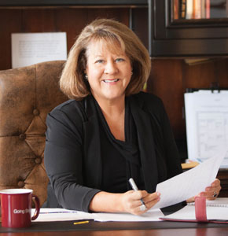
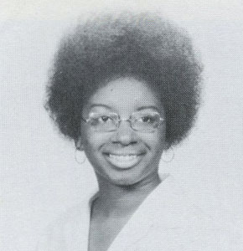
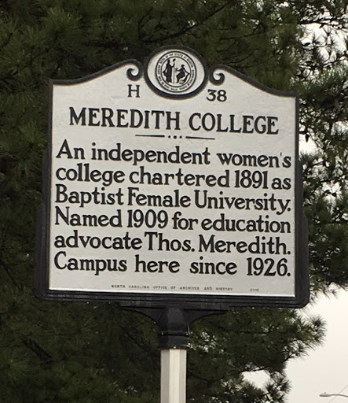
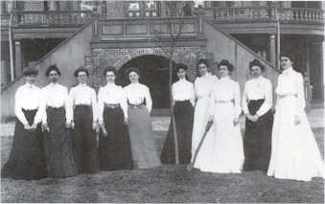
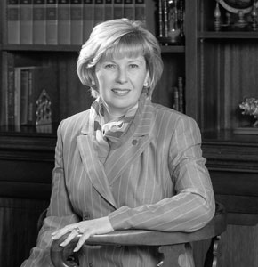
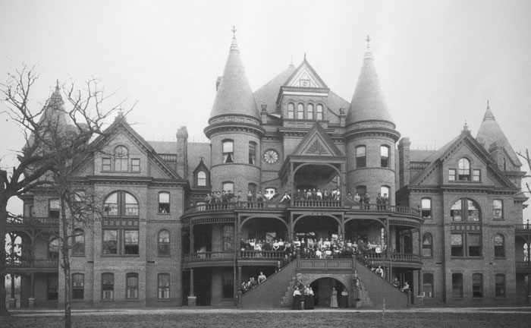
A Timeline of Meredith College
1835-2011
Retrieved: www.meredith.edu/news/meredith-college-timeline, 2020
Retrieved: infotogo.meredith.edu/archives_collegehistory/arch_immortalten, 2020
Retrieved: http://www.ncmarkers.com/Markers.aspx?MarkerId=H-38, 2020
Notes:
Meredith College was founded following the establishment of the University of North Carolina at Chapel Hill by the state, Greensboro College in 1838 by the Methodist Church, and St. Augustine's College in 1867 by the Episcopal church. Meredith is now a Historical Landmark in Raleigh, North Carolina. [click]
At this time, North Carolina realized that the higher education options for the women were lacking. Conversations began "In 1835 (when) the North Carolina Baptist State Convention met and debated the possibility of forming," as Thomas Meredith a member of the committee proposed, "a 'female seminary of higher order'…however, [click] the Baptist Convention did not commission a female school until 1889" (Martin, 2016, para. 2).
Meredith College, [click x2] then known as the Baptist Female University, was chartered in 1891, and [click] had their first student enrollment in 1899. Three years later, [click x 2] they had their first graduating class of just ten students in 1902. These students, now known as the "immortal ten" are icons to all students and alumnae. Interestingly enough, the first graduating class paid just $165.50 per year for room, board, and tuition. They also started the school's endowment through their contribution of $19.75. [click x2]
Later in 1909, the name was changed for the second time to Meredith College to honor Thomas Meredith, as it was his proposal that began the process of Meredith College's origin. "The name's lack of pretentiousness its brevity, and it beauty of sound were welcome," the vice-president of the college, Johnson said (Maxwell, 2016, para 11). [click x2]
In 1921, Meredith was admitted to the Southern Associations of Colleges and Schools, [click] and in 1928, Meredith College was the first women's college in North Carolina to receive the distinction of "approved colleges" by The Association of American Universities. It was the fourth school in North Carolina to receive this distinction. [click]
Meredith also has a history of supporting underrepresented students. [click] Gwendolyn Matthews Hilliard, the school's first African American student graduated in 1971. [click x2] In 1974 Dr. Sandra Thomas became the college's first female vice president, and under her leadership the school took up the cause of women's rights. In fact, in 1997, [click] "Meredith College broke its close ties with the Baptist State Convention to give the school autonomy amid concerns about the convention's views on women" (Maxwell, 2016 para. 50).
[click x2] In 1999 Dr. Mareen A. Hartford became Meredith's first female president, and upon her retirement in 2011 [click x3] a Meredith graduate, Dr. Jo Allen took her place.
Currently, under Dr. Jo Allen's leadership, Meredith is focusing on personal and professional development programs for students and graduates, adult education programs, international education at their campus in Sansepolcro, Italy, and various other endeavors. Financially there is a focus on increasing the College's endowment to provide further stability and accessibility to students in the future. [click]
References
Martin, J. (2016). Meredith College. Retrieved January 23, 2020, from https://northcarolinahistory.org/encyclopedia/meredith-college/
Maxwell, L. (2016, February 25). Meredith College Timeline. Retrieved January 23, 2020, from https://www.meredith.edu/news/meredith-college-timeline
Meredith College. (n.d.). Retrieved January 23, 2020, from https://collegescorecard.ed.gov/school/?198950-Meredith-College
Immortal ten: https://infotogo.meredith.edu/archives_collegehistory/arch_immortalten
Historical marker: http://www.ncmarkers.com/Markers.aspx?MarkerId=H-38
Everything else: https://www.meredith.edu/news/meredith-college-timeline#

Slide 8
Distinctive Senior Leadership
Notes:
Along these same lines, let's further examine the governance structure and distinctive senior leadership of Meredith College. [click]

Slide 9
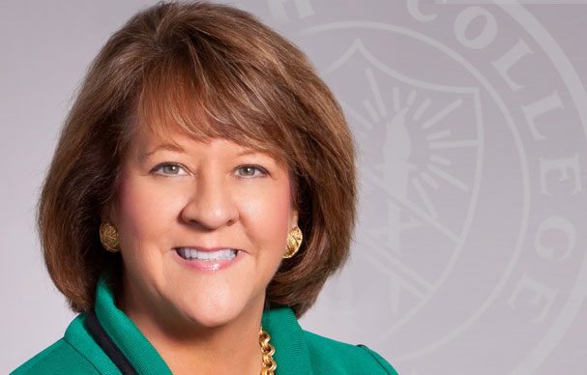
Dr. Jo Allen ‘80
President of Meredith College from 2011
Board of Trustees
Executive Leadership
Longevity
35 members
25 of which are Meredith College alumni
Chair, Vice Chair, and Previous Chair are all Meredith College Graduates
8 members
Efficient communication
Members from administration and academic departmental heads
8 presidents of the college between 1899 – present
Each President has met or exceeded goals for endowment growth and campus expansion
Retrieved: https://www.meredith.edu/president, 2020
Notes:
Meredith College’s Board of Trustees includes 35 members. 25 of these members are graduates of Meredith College. Interestingly enough, the 10 members of the board who are not Meredith Graduates are men. Presumably they have close connection to the college through either being a professor or a part of the administration in the past. The chair, the vice chair, and the previous chair are all graduates of Meredith College. This suggests that the college really values their alumni and respect the degree and experience that their graduates hold. [click]
The senior leadership is a fairly small group of people, so it seems like they must need to cooperate with each other closely. Information is probably shared quickly and efficiently. President Jo Allen is the first Meredith College graduate to be President of the college, and her initiatives to improve the college have been improving quicker and more smoothly than projected. This suggests that there is agreement and teamwork in the senior leadership. [click]
Most surprising is the longevity and qualifications of the members of the board and executive leadership. The positions seem to not experience a lot of turnover from one year to the next. For example, there have only been eight presidents of the college between the years of 1899 – present. Each president has facilitated, met, or exceed their goals for endowment growth, more student enrollment, and campus expansion. These goals could not have been met or exceeded without having executive leadership that has strong communication and the ability to work closely. The continued small size of the executive leadership reflects this trend. [click]
Going Strong. (n.d.). Retrieved January 23, 2020, from https://www.meredith.edu/
Picture of Dr. Jo Allen: https://www.meredith.edu/president

Slide 10
04
Financial Revenue & Expenditure
Notes:
Finally, let's get into the some details of revenue and expenditure to further analyze the priorities and goals of the college and its leadership. [click]

Slide 11
Core Revenues per FTE enrollment, by source: Fiscal year 2018
Tuition and fees
$18,498
Government grants and contracts
$99
Private gifts, grants, and contracts
$4,840
Investment Return
$3,843
Other core revenues
$777
Total
$28,057
Retrieved:https://nces.ed.gov/ipeds/datacenter/institutionprofile.aspx?unitId=198950, 2020
Notes:
Here is the breakdown of Meredith College's core revenues in the 2018 fiscal year. Please feel free to refer to this overview as needed following a brief analysis of the two largest revenue sources. [click]
Meredith College Institutional Profile. (n.d.). Retrieved February 19, 2020, from https://nces.ed.gov/ipeds/datacenter/institutionprofile.aspx?unitId=198950

Slide 12
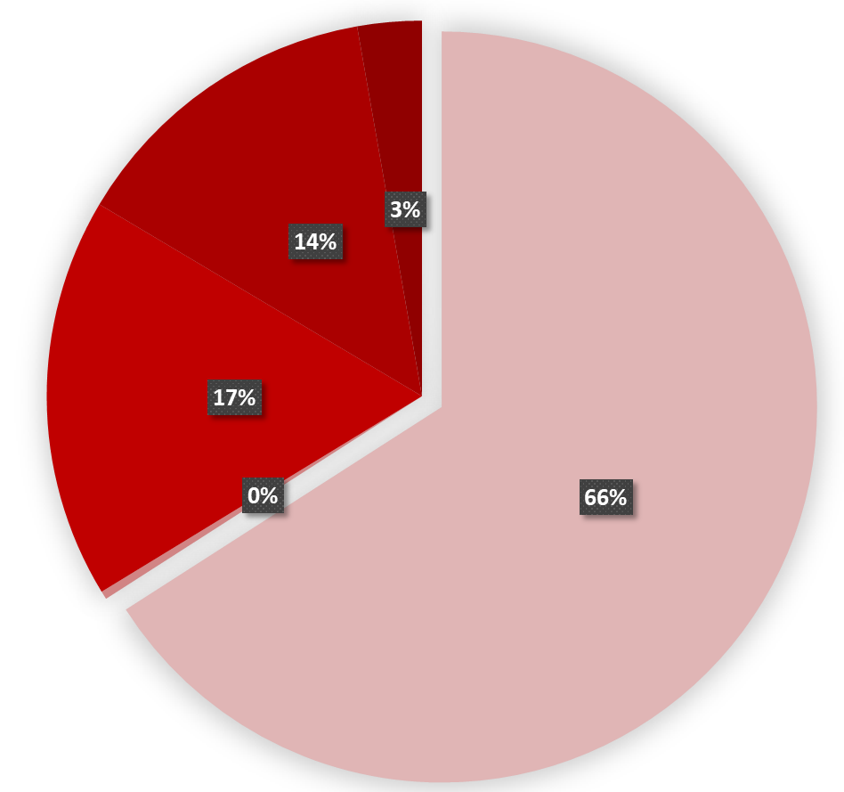
Tuition Driven Institution (66%)
True liberal arts college
Potential accessibility issues
Endowment scholarships
Retrieved:https://nces.ed.gov/ipeds/datacenter/institutionprofile.aspx?unitId=198950, 2020
Notes:
The largest proportion of Meredith College's revenue comes from tuition and fees (66%) indicating that they are a tuition driven institution. This poses potential accessibility issues to underprivileged students. [click]

Slide 13
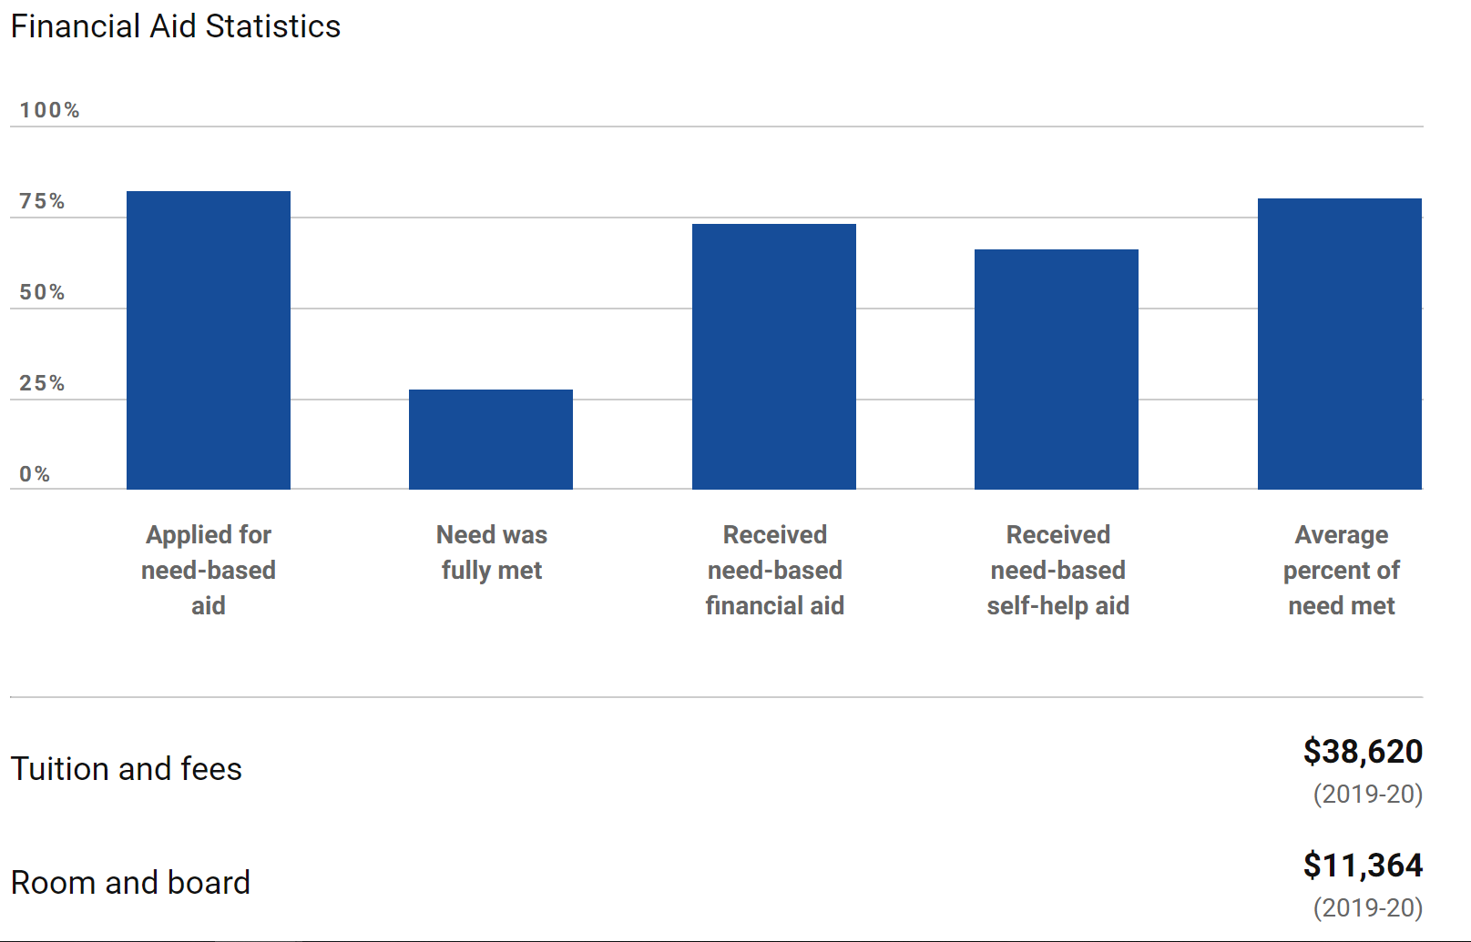
Private Gifts & Endowment Returns (17%)
Growing endowment: primary goal of current and past 3 presidents
Extensive network of financially involved alumni
Founders’ Week – Giving Day
Meredith College, Beyond Strong
Retrieved:https://nces.ed.gov/ipeds/datacenter/institutionprofile.aspx?unitId=198950, 2020
Retrieved: https://www.usnews.com/best-colleges/meredith-college-2945, 2020
Notes:
Their second largest source of revenue comes from private gifts and endowment returns (17%). This is not surprising as a primary goal of the president, and the previous three presidents, of the college is growing the endowment. One key use of the endowment is the ability to award financial aid. [click] This graph from the U.S. Meredith College demonstrates the large amount of financial aid that students receive. This graph reflects financial aid from the government as well as aid from the college, nevertheless, Meredith awards large amounts of scholarships to its students from the endowment. [click] Meredith also has an extensive network of financially involved alumni and donors which is reflected by both its most recent fundraising efforts: "Founders' week specifically giving day" Which occurs every year, and in the fundraising campaign, Beyond Strong, lead by President Jo Allen shortly after she took office in 2011. [click]

Slide 14
Retrieved: https://www.meredith.edu/beyondstrong, 2020
Notes:
The campaign began in July 2012 and ended in December 2018 with the goal of raising $75 million, but surpassed its goal by over $15 million with a final amount of $90,466,720. In the future Meredith's revenue can be expected to see an overall growth of private gifts and endowment returns in their profile. [click]
Photo: https://www.meredith.edu/beyondstrong,

Slide 15
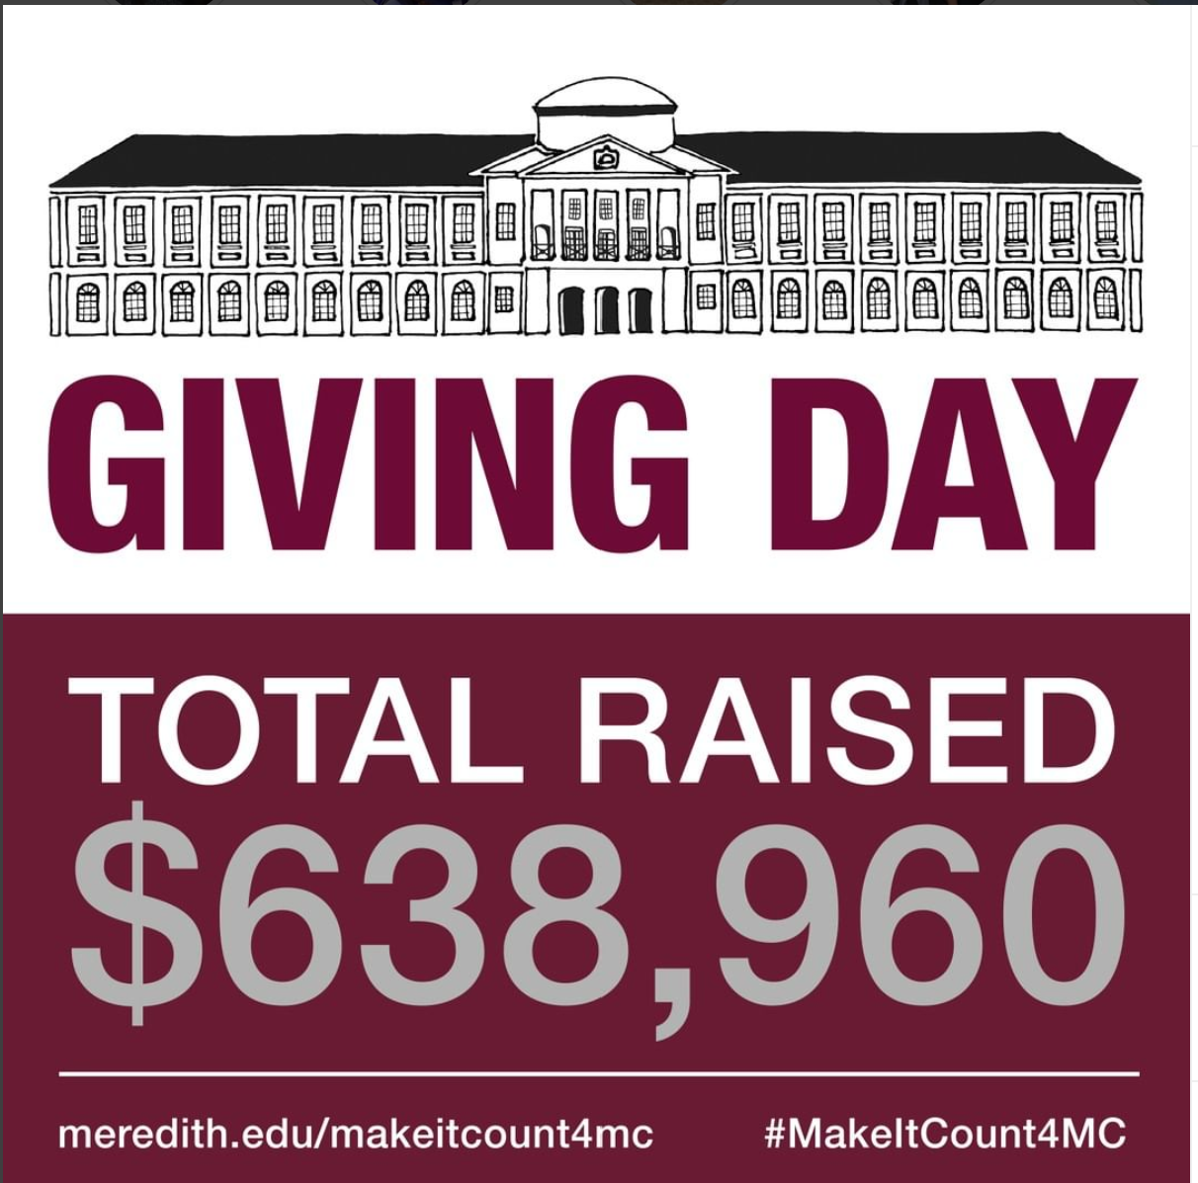
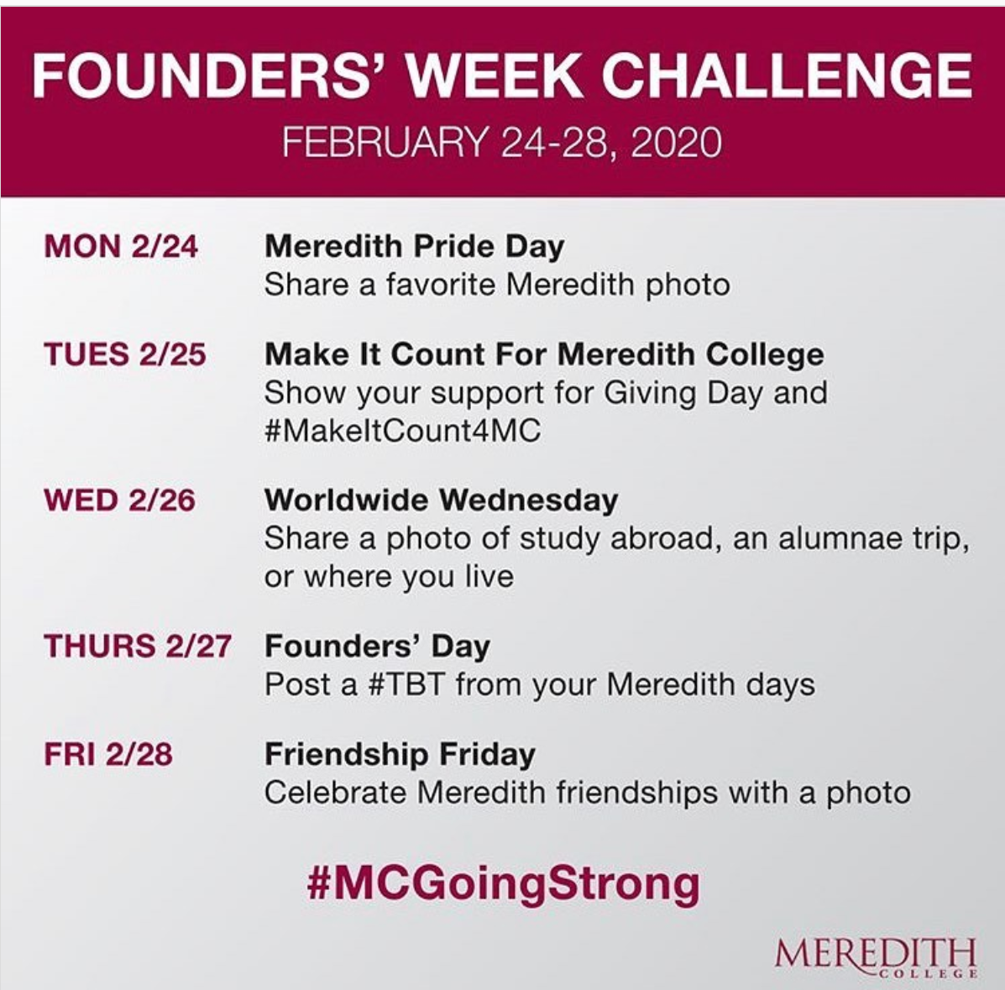
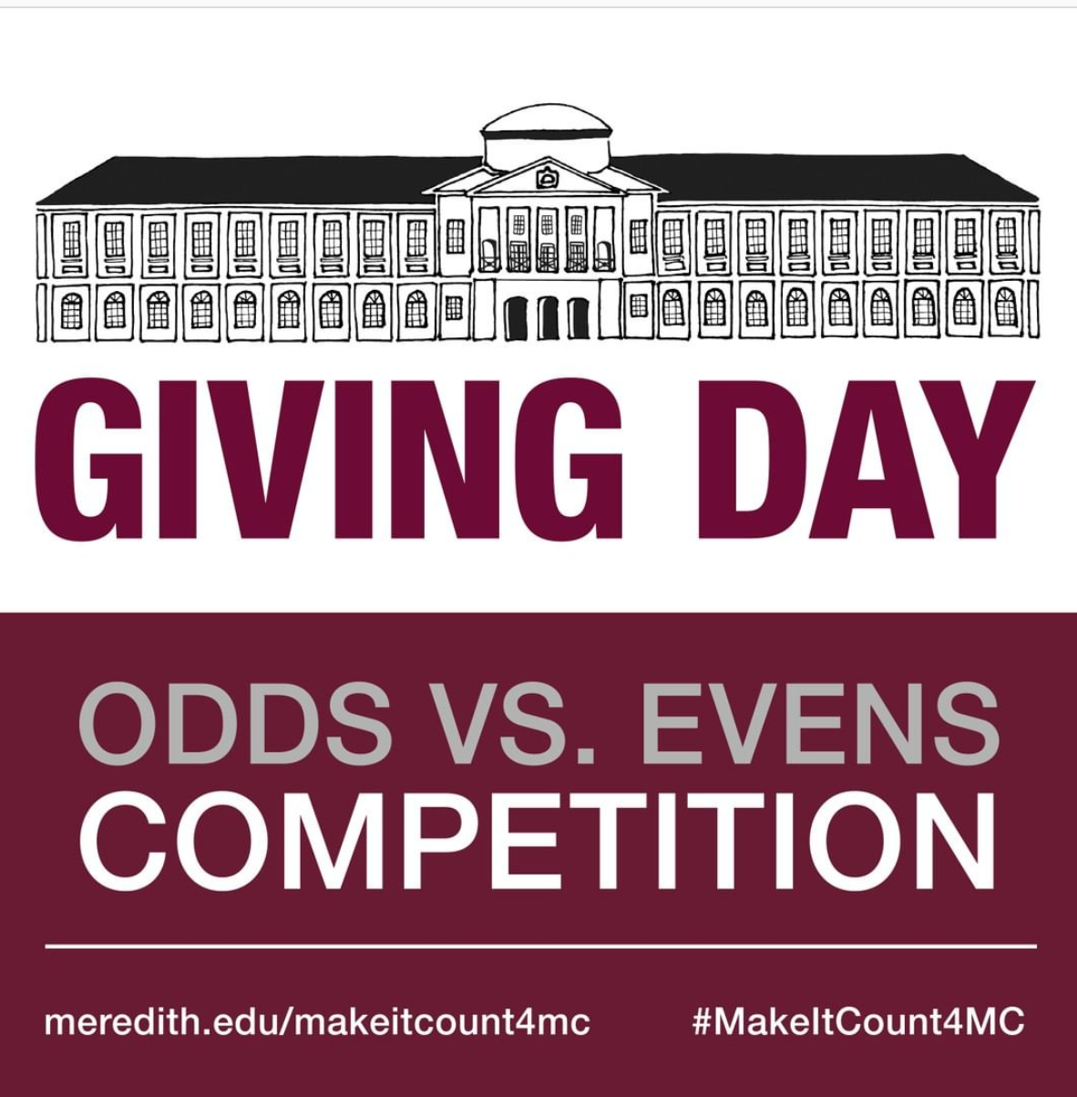
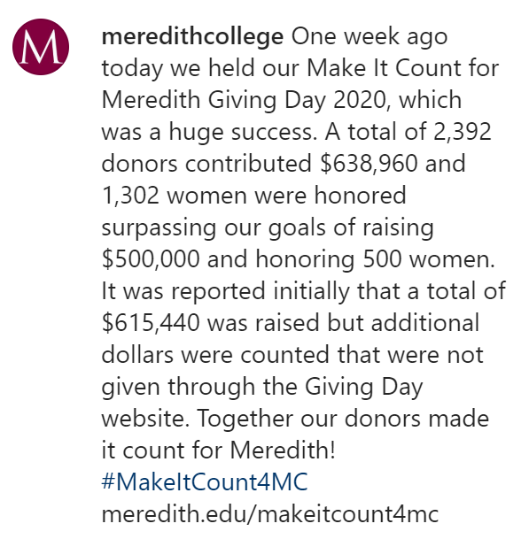
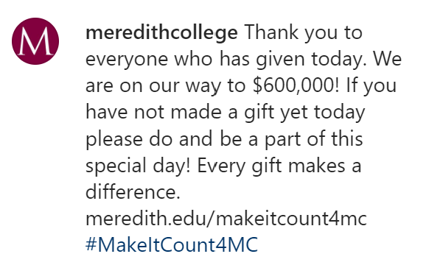
FUNDRAISING:
Meredith’s Success
Retrieved: https://www.instagram.com/p/B880HMWn6Dv/, 2020
Retrieved: https://www.instagram.com/p/B9A-CndH6mH/, 2020
Retrieved: https://www.instagram.com/p/B8_1qumjceP/, 2020
Retrieved: https://www.instagram.com/p/B9AmOyQnm4S/ . 2020
Retrieved: https://www.instagram.com/p/B9SVm-RFNVW/ , 2020
Notes:
Through taking a quick look at Meredith's most recent fundraising campaign, Founders week - giving day, let's discuss some possible reasons for Meredith's success in fundraising. First, There are several weeks leading up to Founders week where alumni are contacted through e-mail, letters, and social media to notify them of the event. The following pictures are from Meredith's main Instagram account. As you can see, they start with Meredith Pride on Monday, to help donors celebrate their memories or connections with Meredith as a community.
Then, Tuesday is a competition for giving [click] Later we will more closely look at some of the traditions that help Meredith's student retention, but there is fierce competition between students who graduate in even years and those that graduate in odd years. For example, a graduate of 2015 has a "big sister - partner class" of graduates from 2013, and they have a "little sister - partner class" of graduates from 2017. This creates community and brings back memories of competitions with your "odd or even" classmates now as alumni. [click]
Throughout the day the college continues to update it's social media with which group is in the lead with giving, if they have reached their goal, and photos of the celebrations that are happening on campus. [click]
At the end of the day, there is a report of how much was raised, a prompt thank you, posts reflecting some of the people honored through donor's gifts, and [click] a celebration including a personal thank you from the president and her dog, bachelor, who has attended every major event since Dr. Jo Allen became president in 2011.
All of these things bring back the feeling of pride, inclusion, family, and thankfulness for the college in many alumni. They also show how much the gifts mean to the students, faculty, and governance of the college which is appreciation that goes a long way with donors.
So, How is all of this money spent? [click]
Founders week: https://www.instagram.com/p/B880HMWn6Dv/
Leaders of the college – dean Jackson and president jo allen, parents, past alumni, and current students (with updates of the giving so there is slight pressure to support the institution that is bringing up nostalgia): https://www.instagram.com/p/B9A-CndH6mH/
Giving Day: https://www.instagram.com/p/B8_1qumjceP/
Bachelor : https://www.instagram.com/p/B9AmOyQnm4S/
Totals reached, thank you’s and celebrations: https://www.instagram.com/p/B9SVm-RFNVW/ celebrations: https://www.instagram.com/p/B9A1xBXnDo2/

Slide 16
Core expenses per PTE enrollment, by function: Fiscal year 2018
Instruction
$10,837
Research
$0
Public service
$176
Academic support
$3,920
Student support
$2,594
Institutional support
$7,095
Other core expenses
$0
Total
$24,622
Retrieved:https://nces.ed.gov/ipeds/datacenter/institutionprofile.aspx?unitId=198950, 2020
Notes:
Clearly, the majority of Meredith's budget is spent on Instruction (44%) and Institutional support (29%). Indicating that their primary focuses are supporting, recruiting, and retaining qualified faculty.
Looking closer at these categories, [click]
https://nces.ed.gov/ipeds/datacenter/institutionprofile.aspx?unitId=198950
Meredith College Institutional Profile. (n.d.). Retrieved February 19, 2020, from https://nces.ed.gov/ipeds/datacenter/institutionprofile.aspx?unitId=198950

Slide 17
Institutional Support (29%)
A college is a business
Retention of qualified Administrators
Social media staff
Alumni relations
Admissions or financial officers
Retrieved:https://nces.ed.gov/ipeds/datacenter/institutionprofile.aspx?unitId=198950, 2020
Notes:
the finances allotted for institutional support cover a large variety of expenditures, but a business cannot run smoothly without retaining qualified administrators and providing resources for these professionals to do their job. As seen in the previous slide, having involved faculty such as the social media staff and alumni relations, is an investment that is invaluable to future potential revenue. This thought process also applies to admissions officers, financial officers, and other administrative personal who help the business run smoothly. [click]

Slide 18
Instruction (44%)
College value
Faculty retention
Student academic support
Teaching Resources
Retrieved:https://nces.ed.gov/ipeds/datacenter/institutionprofile.aspx?unitId=198950, 2020
Notes:
A similar thought process applies to the 44% of instruction as a college is only as valuable as the academic education it provides. Through spending the majority of the budget on instruction, the college is investing in faculty support and retention, student academic support and success, and consistent access to instructional materials. [click]

Slide 19
Unexpected Expenditure
Student services (11%) & Academic Support (16%)
Many clubs, activities, support
0% spent on research
Laboratories and new projects yearly
Retrieved:https://nces.ed.gov/ipeds/datacenter/institutionprofile.aspx?unitId=198950, 2020
Notes:
It is noteworthy to evaluate the small amount of budget that the student services (11%) and academic support (16%) takes up. Meredith College boasts many clubs, activities, and support for their students,
so it could be expected to take up a larger portion of the expenditure profile. It is also surprising that $0 are spent on research as Meredith has several laboratories with various new projects being pursued each year. I look forward to investigating which expenditure category this research would fall under or how it is funded as Meredith does not receive any state appropriations or governmental grants and contracts.
Through this brief evaluation of Meredith College's expenditure profile, their immense value of instruction and institutional support can be seen. They clearly believe that investing in quality teaching and support staff could bring a favorable financial return in the future. They also rely heavily on tuition & fees, endowment return, and private gifts, so investing expenses on quality instruction will eventually generate prepared alumni who will, hopefully, feel grateful to the college. Their financial profile shows forward-thinking and current investment into supporting the long-term goal of a large endowment. [click]

Slide 20
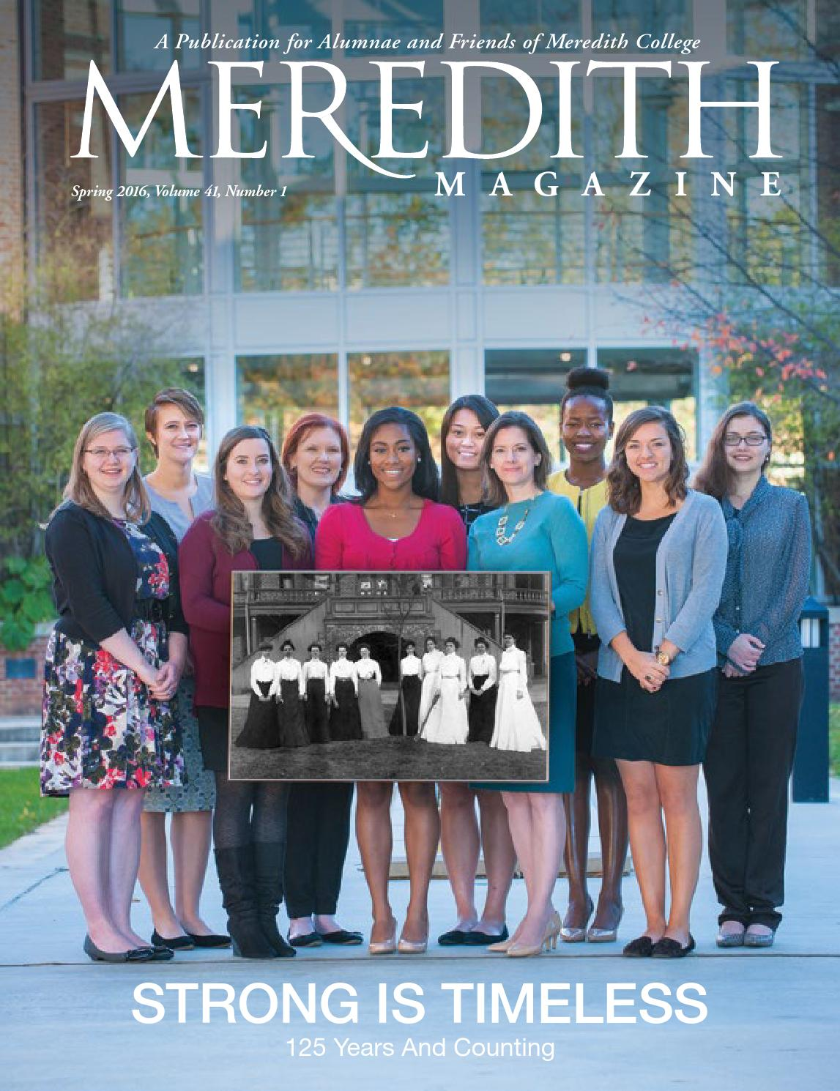
Questions?
Retrieved: https://issuu.com/meredithcollege/docs/spring2016magazine_issuu, 2020
Notes:
Thank you for your time, and I hope you enjoyed learning more about Meredith College's classification, history, governance, and financial revenue and expenditure. [click] Are there any questions? [click]
https://issuu.com/meredithcollege/docs/spring2016magazine_issuu

Slide 21
References
Going Strong. (n.d.). Retrieved January 23, 2020, from https://www.meredith.edu/
How Does Meredith College Rank Among America's Best Colleges? (n.d.). Retrieved January 29, 2020, from https://www.usnews.com/best-colleges/meredith-college-2945
How U.S. News Calculated the 2020 Best Colleges Rankings. (n.d.). Retrieved January 29, 2020, from https://www.usnews.com/education/best-colleges/articles/how-us-news-calculated-the-rankings
Martin, J. (2016). Meredith College. Retrieved January 23, 2020, from https://northcarolinahistory.org/encyclopedia/meredith-college/
Maxwell, L. (2016, February 25). Meredith College Timeline. Retrieved January 23, 2020, from https://www.meredith.edu/news/meredith-college-timeline
Meredith College. (n.d.). Retrieved January 23, 2020, from https://collegescorecard.ed.gov/school/?198950-Meredith-College
Meredith College Institutional Profile. (n.d.). Retrieved February 19, 2020, from https://nces.ed.gov/ipeds/datacenter/institutionprofile.aspx?unitId=198950
Penn State World Campus. (n.d.). In HIED 545: Foundations of Higher Education and Student Affairs: Spring 2020. Retrieved from https://psu.instructure.com/courses/2043984/modules
The Carnegie Classification of Institutions of Higher Education ®. (n.d.). Retrieved January 29, 2020, from https://carnegieclassifications.iu.edu/lookup/view_institution.php?limit=0,50&clq=&start_page=lookup.php&backurl=lookup.php&unit_id=198950&submit=FIND

