Slide 1
A Versitile SIS System for a Verstile Institution
The office of the Provost
Notes:
Fischer, A. (2018). Using salesforce as a student information system SIS. Youtube. https://www.youtube.com/watch?v=ac6jwR8RkSg.
Hult International Business School. (2017). A business school ready for anything. Hult. www.hult.edu.
123 RF. (n.d.). Group of happy business people. 123rf. https://www.google.com.hk/url?sa=i&url=https%3A%2F%2Fwww.123rf.com%2Fphoto_21668558_group-of-happy-business-people-with-placard-over-white-background.html&psig=AOvVaw0XzaGKrqMLVnXu1Bai8NHz&ust=1617625193969000&source=images&cd=vfe&ved=0CAIQjRxqFwoTCMiyx8_J5O8CFQAAAAAdAAAAABAR

Slide 2
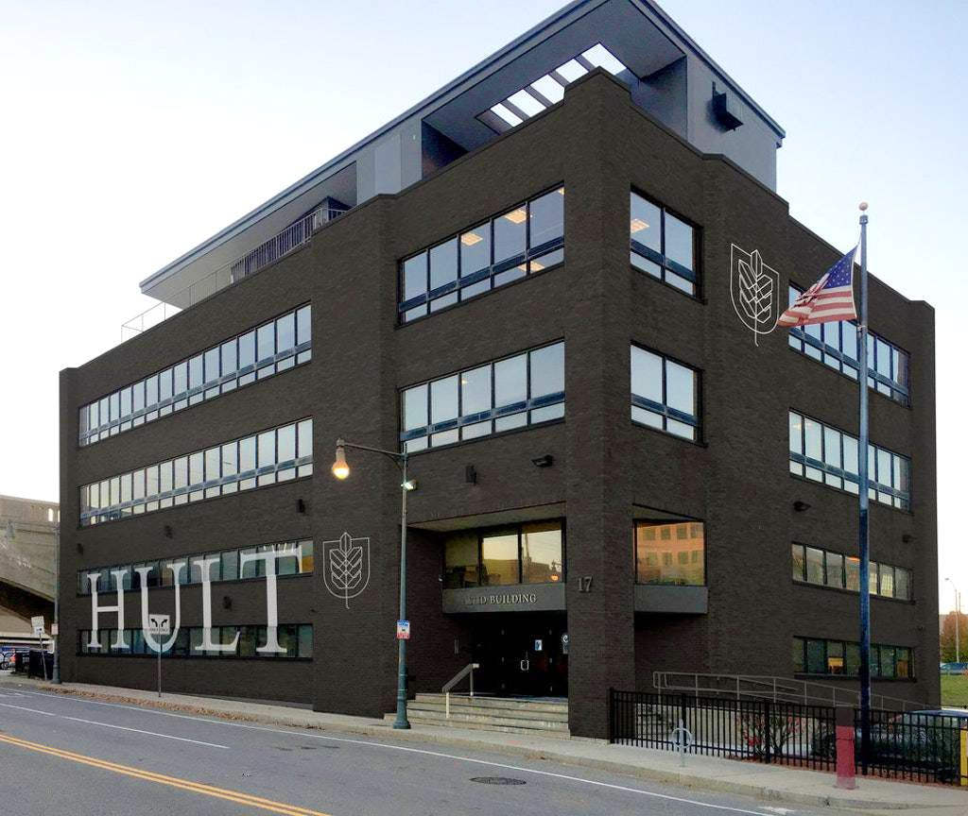
Multi-Campus Complications
1
Why have 10+ systems when you can have one?
Notes:
Fischer, A. (2018). Using salesforce as a student information system SIS. Youtube. https://www.youtube.com/watch?v=ac6jwR8RkSg.
Hult International Business School. (2017). A business school ready for anything. Hult. www.hult.edu.

Slide 3
Accessiility for Students
Portal access
Unofficial transcript
Degree Audit
Student's road map through the program
Registration Page
Course title
Rules in place to pick up conflicts & pre-recs
Sense of urgency by showing students what is filling up
Notes:
Fischer, A. (2018). Using salesforce as a student information system SIS. Youtube. https://www.youtube.com/watch?v=ac6jwR8RkSg.
Hult International Business School. (2017). A business school ready for anything. Hult. www.hult.edu.

Slide 4
Removing Silos
Faculty
Easily input grades, red-flags, attendance, and more.
Easily access relevant student’s administrative data
Staff
Instant updates of course offerings, registration, and more
Easily access a student’s academic history to identify concerns early
Notes:
Fischer, A. (2018). Using salesforce as a student information system SIS. Youtube. https://www.youtube.com/watch?v=ac6jwR8RkSg.
Hult International Business School. (2017). A business school ready for anything. Hult. www.hult.edu.

Slide 5
Flexibility in Registration
Transparency with less administration
Real-time attendance tracking
students can submit reasons why they are absent through the portal
All faculty data housed in one portal
Manage and view course-loads
Track and plan events to attend
.
Advising is integrated into the same system
Can see term grades
Live look at the student degree audit
Allows advisors to see student at any time
Notes:
Fischer, A. (2018). Using salesforce as a student information system SIS. Youtube. https://www.youtube.com/watch?v=ac6jwR8RkSg.
Hult International Business School. (2017). A business school ready for anything. Hult. www.hult.edu.

Slide 6
Training
Training will be available throughout the month of April every Monday, Wednesday, and Friday from 9-10am and 2-3 pm at the technology center
Notes:
Fischer, A. (2018). Using salesforce as a student information system SIS. Youtube. https://www.youtube.com/watch?v=ac6jwR8RkSg.
Hult International Business School. (2017). A business school ready for anything. Hult. www.hult.edu.

Slide 7
Ongoing process We will continue to customize based on suggestions from you!
Notes:
123 RF. (n.d.). Group of happy business people. 123rf. https://www.google.com.hk/url?sa=i&url=https%3A%2F%2Fwww.123rf.com%2Fphoto_21668558_group-of-happy-business-people-with-placard-over-white-background.html&psig=AOvVaw0XzaGKrqMLVnXu1Bai8NHz&ust=1617625193969000&source=images&cd=vfe&ved=0CAIQjRxqFwoTCMiyx8_J5O8CFQAAAAAdAAAAABAR
Fischer, A. (2018). Using salesforce as a student information system SIS. Youtube. https://www.youtube.com/watch?v=ac6jwR8RkSg.
Hult International Business School. (2017). A business school ready for anything. Hult. www.hult.edu.

