Slide 1
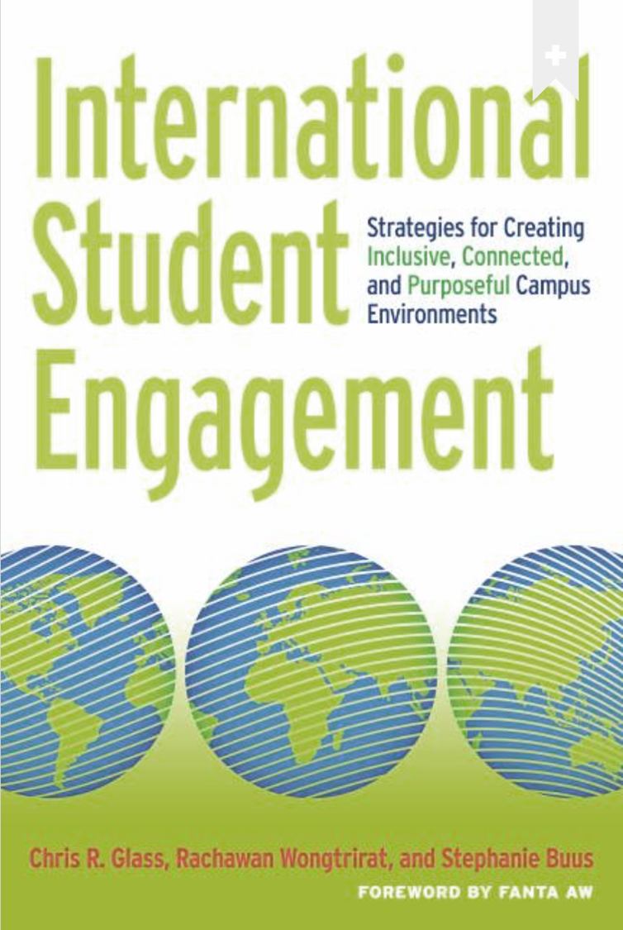
International Student Engagement:
Strategies for Creating Inclusive, Connected, & Purposeful Campus Environments
Authors: Chris G., Rachawan W, & Stephanie B.
Presented by: Emily Lane

Slide 2
Overview & Purpose
1
Exploring higher education’s actions that yield more inclusive, connected, and purposeful campus environments for their international students

Slide 3
There is not one culture but there are cultures. You cannot judge any culture based on the standards of your own culture because you’ll always be wrong
Notes:
(23)

Slide 4
Overview & Purpose
Why
How
Where
Exploration of approaches to the academic and social integration of international students at U.S. colleges and universities
First-person narrative experiences
Analysis of datasets
Campus-level case examples
Discussions of contemporary issues and trends
Community colleges
Liberal arts institutions
Public flagship research universities
Rural and urban

Slide 5
How do the authors convey their purpose?
2
Investigation of curricular experiences, cocurricular experiences, friendship networks, relationship with family members, and campus contexts to foster a sense of belonging

Slide 6
Curricular Experiences
Confidence & sense of accomplishment
Faculty-Student interaction is foundational
Adapt better in discussion-filled classrooms rather than silently listening to a lecture

Slide 7
Cocurricular Experiences
Increased small-world acquaintances
Cross-cultural engagement enhances student’s sense of belonging
Involvement in leadership positions increases satisfaction and trust in the institution

Slide 8
Role of Friendship Networks
Excluded from close friendships with American students
Closest friends are other international students
Intercultural friendships reflecting durability of their own national identity
Friendships bring stability and support networks

Slide 9
Relationship With Family Members
Family members are international students’ main support
Community support and pressure
Social media
Unites and stabilizes students
Increased anonymity and frequency of racist events

Slide 10
Campus Contexts That Foster a Sense of Belonging
Shift from focusing on vulnerabilities
Focus on resilience and strength
Value noneconomic forms of capital
Language proficiency
Cultural knowledge
Social relationships

Slide 11
A critically important outcome of college is the formation of new social relationships. If two students both receive high GPAs yet one student receives a plum job offer owing to social relationships while another student does not, the outcomes for these students cannot be said to be equal.
Notes:
(88) “…If two students both achieve high scores on the graduate entrance exams, but one student feels isolated and alone while the other student feels connected and participatory, the outcomes for these students cannot be said to be equal either”

Slide 12
Five Divides
1
The surge in undergraduate recruitment and enrollment
2
The increasingly varied academic preparedness of international students
3
The local and global tensions manifest from new patterns of global mobility
4
Disparities in financial circumstances
5
The evidence of neo-racist attitudes toward particular subpopulations of international students

Slide 13
Racisism & Safety
Ostracized
Abandoned
Excluded
Concerned for personal safety

Slide 14
Experiences with Racism
A racist encounter that may debilitate one student may incite persistance and resilience in another
Retrieved from: (CCU, 2018)
Notes:
(CCU, 2018)

Slide 15
Recommendations
1
Connect international initiatives with the institutions existing strategic priorities
2
Invest in faculty learning and professional growth
3
Focus on continuous, data-driven approaches to decision making
4
Forge flexible coalitions with key campus stake holders
5
Illustrate your point to key stake holders as your provide the proof through data
6
Increase collaboration and integration with various campus offices and units

Slide 16
My Response & Analysis
3
This book is a summary of years of resarch that involves qualitative and quantitative analysis to evaluate, investigate, and propose solutions for international students in higher education.

Slide 17
Why This Book is so Compelling
Good Questions
Unbiased Evaluation
Proposed Solutions
The authors are skilled in creating research questions that are relevant and measurable across various types of institutions who host students with various countries of origin
The authors evaluate both the positive and negative issues from multiple perspectives so the reader understands a rounded view of hese issues
The authors offer simple solutions that readers could utilize immediately. They also propose long term solutions and advice on how to viably begin pursuing them.

Slide 18
1,075,496
$45 Billion
China
International students studied in America in 2019/2020
International students contributed $45 billion to the U.S. economy in 2018, according to the U.S. Department of Commerce
Was the Largest source of international students in 2019/2020
Sources: (IIE, 2020a) (Mitropoulos, 2020)
Notes:
(IIE, 2020) (Mitropoulos, 2020)

Slide 19
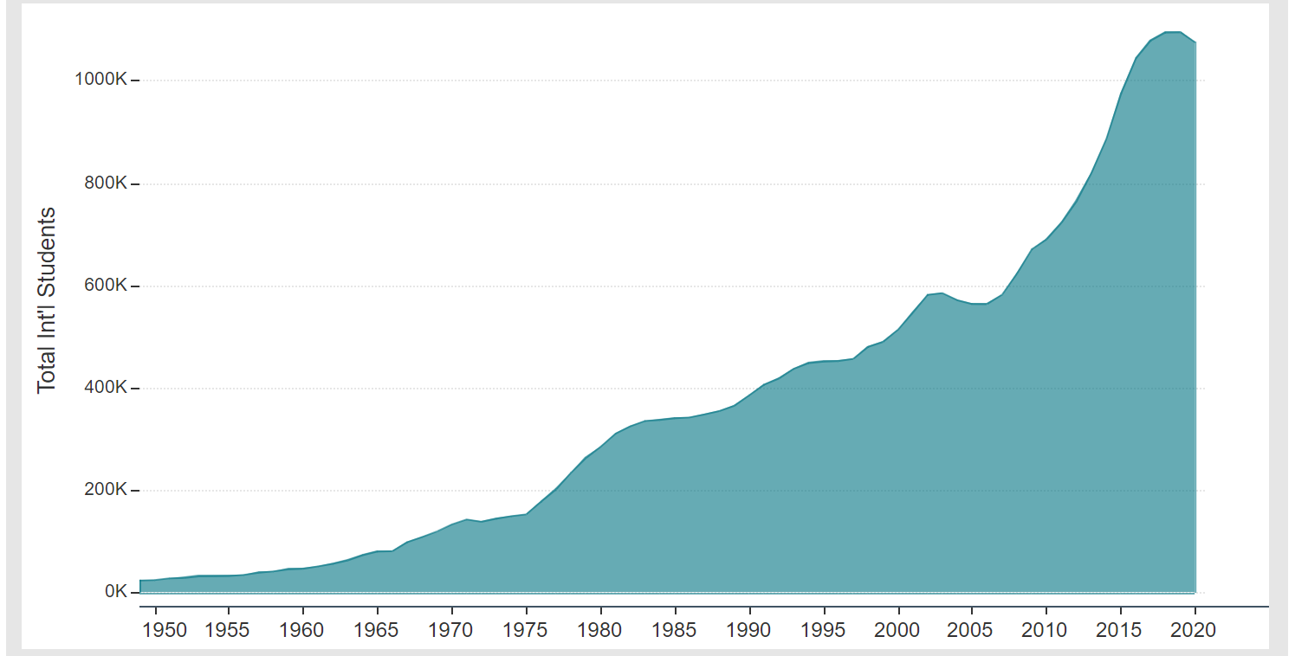
International Student Growth
Retrieved from: (IIE, 2020a)
Notes:
(IIE, 2020a)

Slide 20
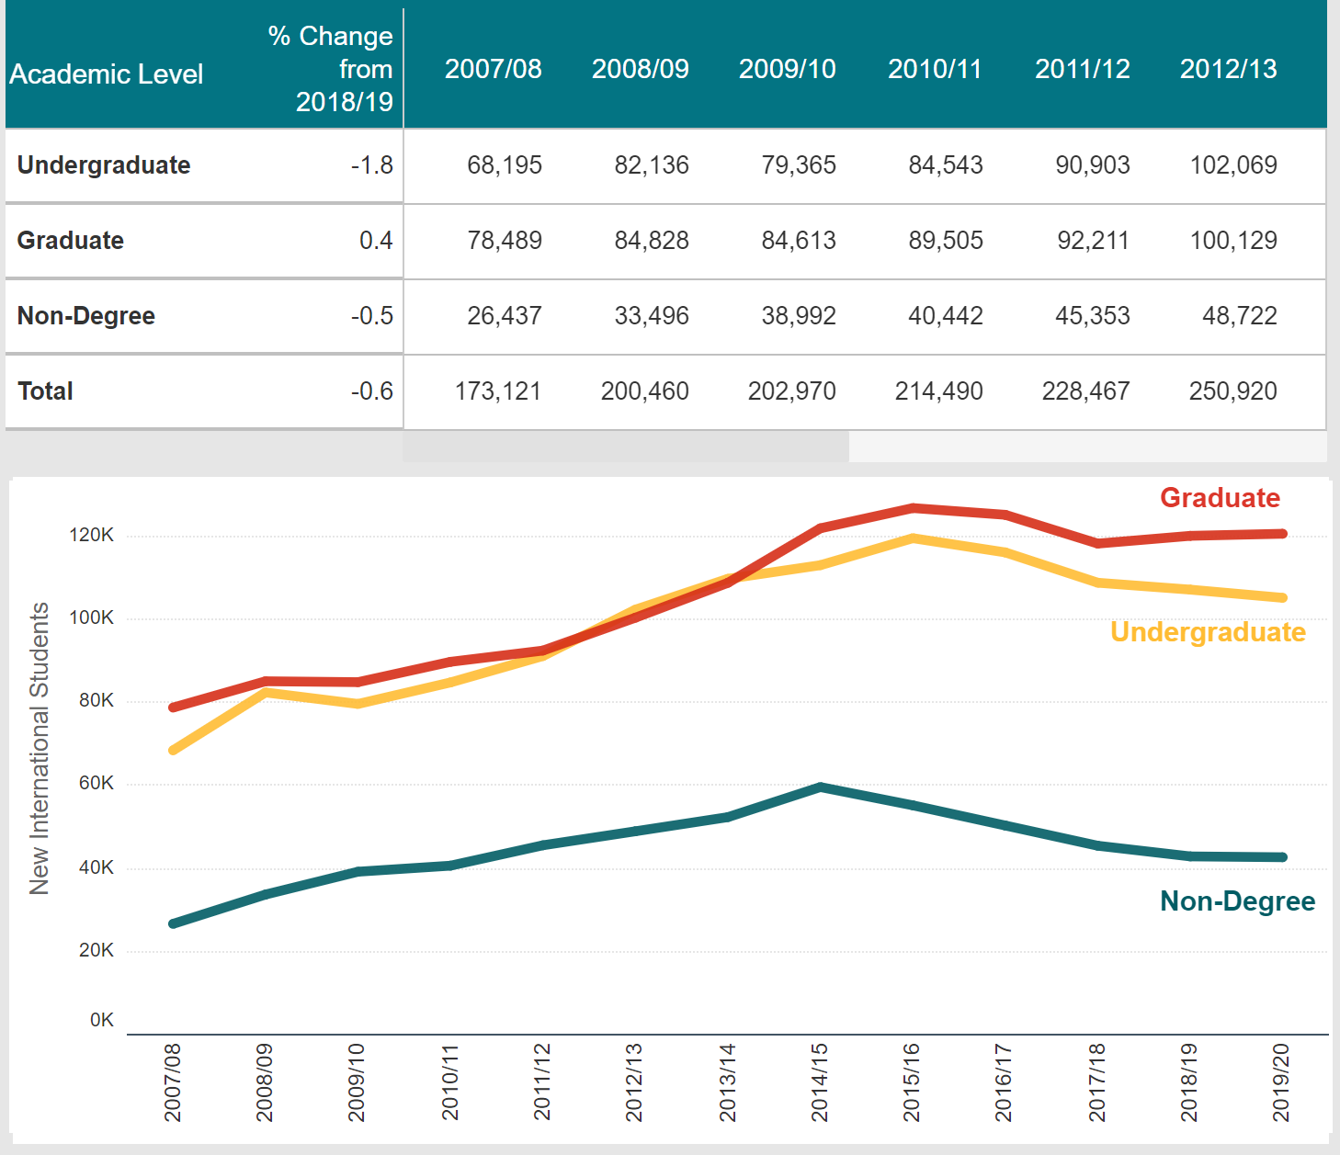
International Student Enrollment Trends
Retrieved from: (IIE, 2020a)
Notes:
(IIE, 2020a)

Slide 21
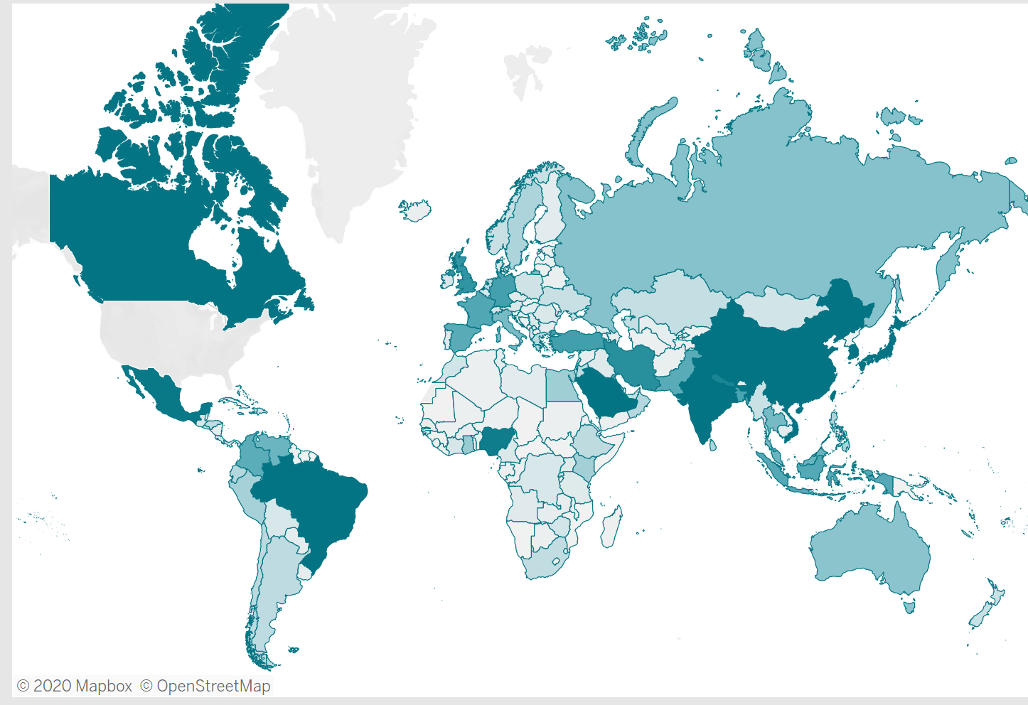
International Student Diversity
Retrieved from: (IIE, 2020b)
Notes:
(IIE, 2020b)

Slide 22
Intended Audience
4
The authors’ intended audience are higher education professionals who value creating inclusive, connected, and purposeful campus environments for current and prospective international students

Slide 23
International Student Advisers
University Faculty & Staff
Anyone Who Appreciates Thorough Research
interested in creating more inclusive, connected and purposeful campus environments for current and prospective international students
who interact with international students or value increasing meaningful student involvement
the book takes readers on a journey to analyze various types of higher education institutions and their strategies to create inclusive, connected, and purposeful campus environments for international students

Slide 24
Questions
5
Any compelling research introduces as many questions as it answers

Slide 25
Further Questions
Input
Environment
Output
With lowering academic standards for international students, what efforts can be made to ensure students are capable of meaningful engagement on campus before the university grants them admission?
If a university is not committed to providing an environment that prioritizes enhancing international student engagement, is it ethical to host international students at that university?
What high impact engagement activities can universities require to increase international student’s attainment of noneconomic forms of capital such as language proficiency, cultural knowledge, social capital, and connection to their community?

Slide 26
References
CCU. (2018, March 12). 5 Facts About CCU’s New Culturally and Linguistically Diverse Emphasis. https://www.ccu.edu/blogs/cags/2018/03/5-facts-about-ccus-new-culturally-and- linguistically-diverse-emphasis/
Glass, C. R., Wongtrirat, R., & Buus, S. (2014). International student engagement: Strategies for creating inclusive, connected, and purposeful campus environments. ProQuest Ebook Central https://ebookcentral.proquest.com
IIE. (2020a). Enrollment Trends. https://opendoorsdata.org/data/international- students/enrollment-trends/
IIE. (2020b). All Places of Origin [Infographic]. https://opendoorsdata.org/data/international-students/all-places-of-origin/
Mitropoulos, A. (2020, July 15). Loss of international students could damage US economy, experts say. ABC News. https://abcnews.go.com/Business/loss-international-students-damage-us- economy-experts/story?id=71754388#:~:text=International%20students%20contributed% 20%2445%20billion,dependent%20on%20the%20revenue%20streams

